Slide 1
Cloud Technology Fundaments 21UCA501

Slide 2
IaaS workloads
The fundamental unit of virtualized client in an IaaS deployment is called a workload. A workload simulates the ability of a certain type of real or physical server to do an amount of work. The work done can be measured by the number of Transactions Per Minute (TPM) or a similar metric against a certain type of system. In addition to throughput, a workload has certain other attributes such as
Disk I/Os measured in Input/Output Per Second IOPS, the amount of RAM consumed under load in MB, network throughput and latency, and so forth. In a hosted application environment, a client’s application runs on a dedicated server inside a server rack or perhaps as a standalone server in a room full of servers. In cloud computing, a provisioned server called an instance is reserved By a customer, and the necessary amount of computing resources needed to achieve that type of physical server is allocated to the client’s needs.

Slide 3
IaaS workloads
A client would reserve a machine equivalent required to run each of these workloads. The IaaS infrastructure runs these server instances in the data center that the service offers, drawing from a pool of virtualized machines, RAID storage, and network interface capacity. These three layers are expressions of physical systems that are partitioned as logical units. LUNs, the cloud interconnect
layer, and the virtual application software layer are logical constructs. LUNs are logical storage containers, the cloud interconnect layer is a virtual network layer that is assigned IP addresses from the IaaS network pool, and the virtual application software layer contains software that runs on the physical VM instance(s) that have been partitioned from physical assets on the IaaS’ private cloud.

Slide 4
IaaS workloads
From an architectural standpoint, the client in an IaaS infrastructure is assigned its own private network. The Amazon Elastic Computer Cloud (EC2), described in detail in Chapter 8, behaves as if each server is its own separate network—unless you create your own Virtual Private Cloud (an EC2 add-on feature), which provides a workaround to this problem. When you scale your EC2 deployment, you are adding additional networks to your infrastructure, which makes it easy to
logically scale an EC2 deployment, but imposes additional network overhead because traffic must be routed between logical networks. Amazon Web Service’s routing limits broadcast and multicast traffic because Layer-2 (Data Link) networking is not supported. Rackspace Cloud (http://www. rackspacecloud.com/) follows the AWS IP assignment model.

Slide 5
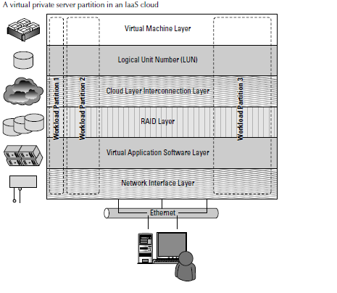
IaaS workloads
FOther IaaS infrastructures such as the one Cloudscaling.com (http://www.cloudscaling. com) offers or a traditional VMWare cloud-assigned networks on a per-user basis, which allows for Level 2 networking options. The most prominent Level 2 protocols that you might use are tunneling
options, because they enable VLANs.

Slide 6
IaaS workloads
Consider a transactional eCommerce system, for which a typical stack contains the following
components:
l Web server
l Application server
l File server
l Database
l Transaction engine
This eCommerce system has several different workloads that are operating: queries against the database, processing of business logic, and serving up clients’ Web pages.

Slide 7
IaaS workloads
The classic example of an IaaS service model is Amazon.com’s Amazon Web Services (AWS). AWS has several data centers in which servers run on top of a virtualization platform (Xen) and may be partitioned into logical compute units of various sizes. Developers can then apply system images containing different operating systems and applications or create their own system images. Storage
may be partitions, databases may be created, and a range of services such a messaging and notification can be called upon to make distributed application work correctly.

Slide 8
THANK YOU

